Slide 1
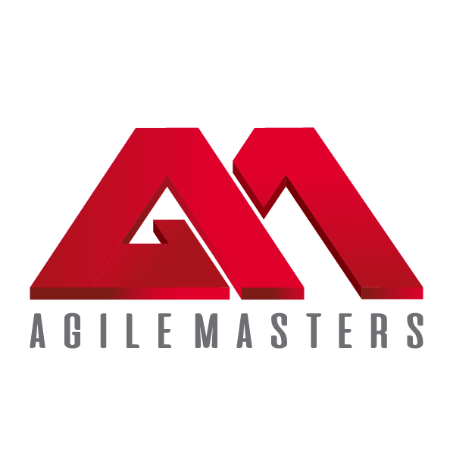
Improving Career Prospects & Workforce Productivity!
AGILE MASTERS INC.
WWW.AGILEMASTERS.ORG

Slide 2
AGILE MASTERS is simply an online & in-person professional training platform that empowers individuals, teams, and organizations with Agile expertise to deliver transformative solutions, support organizational agility, enhance individual productivity, and drive industry growth.
Explore the power of AGILITY
and take advantage of the Agile Masters Online Opportunities with diverse professionals!
WWW.AGILEMASTERS.ORG
…adding value to individuals & organizations!
2

Slide 3
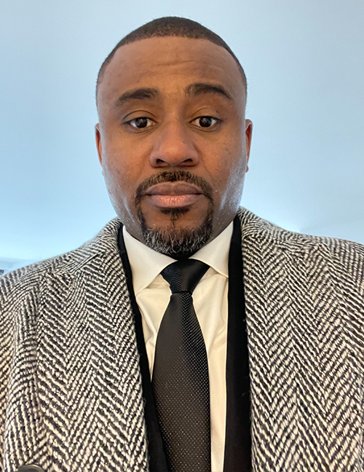
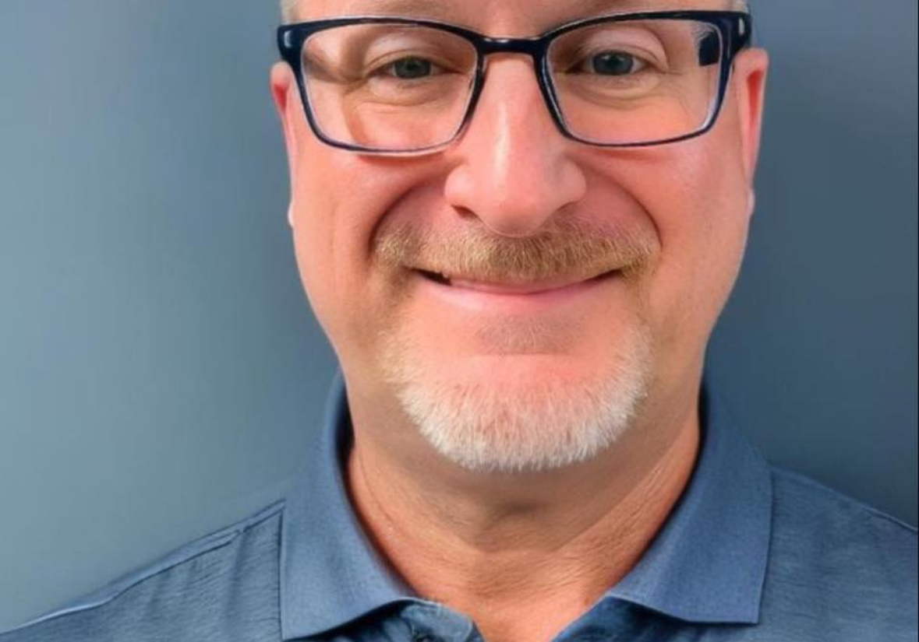
MEET OUR TEAM
Festus a. otabor
Administrator
Beluchi brown
JerEmiah agboiyi
Organization Agility Coach
Agile Transformation Coach
Gary montgomery
Team Support Coach
Visit:
www.agilemasters.org/instructors for more details.
3
Notes:
Note: Insert your picture by clicking on the Picture Place Holder Icon, then send it back!

Slide 4
ACCREDITATION PARTNERS
AGILE MASTERS currently Partners with two major Agile
Globally Accredited Licensing institutes i.e.,
# SCRUMstudy™-VMEdu® which has:
- 2100+ Partners with Employees from 3500+ Companies.
- Certified Over 1,000,000 Professionals in 150+ Countries.
- 7,500+ SCRUMstudy™-VMEdu® Certified Students Monthly
[More than any other Certification Body - as seen on the graph]
# SCALED AGILE INC. - SAFe® [Scaled Agile Framework]:
- The world’s most Trusted System for Business Agility.
- Adopted by more than 20,000 Enterprises Globally.
- Over 1,000,000 Practitioners Trained.
- Supported by more than 500 World-class Transformation
& Platform Corporations in 110+ countries.
[AGILE MASTERS remains ONLY Partner with Robust System
that practically manages its student’ continuous learning - ]
WWW.AGILEMASTERS.ORG
4
Notes:
Note: Insert your picture by clicking on the Picture Place Holder Icon, then send it back!

Slide 5
AGILE MASTERS
REQUEST SUMMARY
WWW.AGILEMASTERS.ORG
The AGILE Masters Training and Certification Program is set to equip mainly Students & Organization Workforce | Executive Leaders with related Agile skills to effectively lead and manage diverse industry.
To support the Global Agile Transformation Drive, we request your institute endorses the Agile Masters Training & Certification Program for its respective Students Executives/Management/Staff—covering the Introduction to Agile [SFC] | Scrum Master Certified [SMC] | Leading SAFe [Certified Course. This drive is designed to leverage on some established regional subsidy to considerably lower the financial cost implication.
Affixed cost of the training is $125 | $975.00 and Agile Masters offers a regional 60-76% subsidy waiver of for All your respective Staff & Students. While your institute further secure other scholarships/support to cover the balance 24-40% toward getting the program available for its respective Staff & Students or have them pay the balance of $30 | $234 | $390 each for the respective courses, as deem fit.
5
Notes:
Note: Insert your picture by clicking on the Picture Place Holder Icon, then send it back!

Slide 6
Program structure
MAJOR Training course modules
Accreditation process
The SMC | SAFe Agilist Course:
This consist a 4-session [3-hours each] Instructor-led live-class training with 1-hr Q&A per session | total of 4-hour follow-up | access to self-study material, exam scheduling, and certification upon passing exam.
This includes access to continuous learning support from instructors & other Agile Experts via the Agile Masters Discourse Platform.
[plus Applicable Internship Opportunity].
Affixed cost of the training per trainee $975 and Agile Masters has secured a 60-76% waiver for all your respective Staff & Students.
Instructor-led Live Classes:
Attend the instructor-led live classes, and
receive initial Certificate of Participation
Covering 2-Continuing Education Unit.
Professional Self-study/Exam/Certification:
Gain access to the advance course materials
and exam scheduling for a more professional accreditation from the Agile Masters Accreditation Institute.
Continuous Professional Development:
Access Agile Masters 24/7 interactive live
coaching support platform for tackling daily challenges, increase productivity, lead effectively, and boost/improve workplace
confidence.
THE COST
$234 | $390 ONLY!
6
WWW.AGILEMASTERS.ORG
Notes:
Note: Insert your picture by clicking on the Picture Place Holder Icon, then send it back!

Slide 7
BENEFITS TO STUDENTS?
1. Enhanced Employability: Agile certification is highly regarded in the job market. It equips students with skills that are in demand, making them more attractive to potential employers.
2. Improved Project Management Skills: Agile practices focus on aiding Students learn how to manage projects effectively, handle changing requirements, and deliver high-quality results.
3. Real-World Experience: Agile training with its hands-on experience is invaluable towards preparing students for the challenges they get to face in their further careers.
4. Collaboration and Teamwork: these Agile key emphases enable students develop strong interpersonal skills, learning how to work effectively in teams and manage team dynamics.
5. Adaptability and Flexibility: these Agile methodologies teach students to how to respond to changes quickly and efficiently, a crucial skill in today’s fast-paced work environment.
6. Innovation and Continuous Improvement: Agile promoting these culture supports students to constantly evaluate and improve their processes, leading to better outcomes.
8. Global Opportunities: Agile as a globally recognized practice, open doors to international job opportunities and collaborations for certified and Agile savvy students.
9. Enhanced Technical Skills: Agile training for IT/Engineering students enhances their skills in software development practices, version control, and other technical aspects of the field.
10. Entrepreneurial Skills: Agile practices assist Students interested in starting own businesses to benefit from its best project and resource management processes with effective team’ leadership.
11. Better Academic Performance: The skills learned through Agile training can also be applied to academic projects, leading to better performance and more successful group projects.
12. Networking Opportunities: Agile Masters training programs provide connect opportunities with professionals in the industry. This leads to mentorship, internships, and job opportunities.
Integrating Agile training and certification into current education system, enable students gain a strong competitive edge, develop valuable skills, and get better prepared for the
Professional World.
10
Notes:
Note: Insert your picture by clicking on the Picture Place Holder Icon, then send it back!

Slide 8
BENEFITS TO institute’ administrators?
1. Enhanced Leadership & Management Skills:
- Agile training focuses on developing strong leadership and management skills, enabling the school administrators effectively lead teams, manage projects, and aid informed decisions.
2. Improved Efficiency and Productivity:
- Agile emphasizes on iterative processes, continuous feedback, and adaptability. This
leads to more efficient workflows and higher productivity within the educational institutes.
3. Better Resource Management:
- Agile practices help in optimizing resource allocation, ensuring time, money and personnel
are used effectively to achieve institutional goals.
4. Enhanced Collaboration & Communication:
- Agile fosters a culture of collaboration and open communication, which improves teamwork among faculty, staff, and students.
5. Adaptability to Change:
- Agile teaches administrators to be flexible and responsive to changes, which is crucial in the dynamic educational environment.
6. Improved Project Management:
- With Agile training, administrators better manage projects, ensuring they are completed
on time and within budget while meeting all the requirements and quality standards.
7. Enhanced Problem-Solving Skills:
- Agile practices encourage a proactive approach to problem-solving, helping administrators identify and address issues before they escalate.
8. Alignment with Modern Educational Trends:
- Agile methodologies align with contemporary educational trends, such as digital transformation and personalized learning, helping institutions stay relevant and competitive.
9. Increased Stakeholder Satisfaction:
- By implementing Agile practices, administrators get to improve satisfaction among students, parents, faculty, and other stakeholders through more responsive and efficient administration.
10. Continuous Improvement Culture:
- Agile promotes a culture of constant progress, encouraging administrators to regularly assess and enhance their processes, policies, and practices.
These benefits gets to help the Educational & Corporate Administrators create a more dynamic, efficient, and responsive education/work environment, ultimately leading to better educational outcomes and institutional success.
11
Notes:
Note: Insert your picture by clicking on the Picture Place Holder Icon, then send it back!

Slide 9
BENEFITS TO the university?
# In Relation to Its Students:
Enhanced Employability: Agile certification gets students at the institute more attractive to potential employers, as they are equipped with industry-relevant skills and practices.
Practical Skills: the Students gain hands-on experience with Agile methodologies, preparing them for real-world challenges in best project management and software development skills.
Competitive Advantage: Agile certification set students at the institute apart from their peers, giving them a competitive edge in job markets.
# In Relation to the Institute:
Curriculum Modernization: Integrating Agile training into the curriculum keeps the educational content current with the global industry standards and practices.
Industry Collaboration: Universities can build stronger partnerships with businesses that value Agile practices, leading to potential internships, projects, & funding opportunities.
Reputation Enhancement: Offering Agile certification enhances the university’ reputation as a forward-thinking institution that prepares students for modern workforce.
# In Relation to the Economy:
Skill Development: Increasing the number of professionals with Agile skills helps close skill gaps in the Country’ IT and Business sectors.
Innovation Boost: Agile practices foster innovation and efficiency, potentially leading to the growth of new businesses in the system and successful startups.
Economic Growth: With a more skilled workforce, companies get to operate more effectively, contributing to overall economic growth.
# In Relation to the Academic Community:
Research Opportunities: Agile methodologies open new areas for academic research and publications.
Faculty Development: Professors & lecturers get to enhance their own skills & knowledge, which they overtime pass on to the students.
Introduction of Agile professional training program in universities significantly contributes to the development of skilled, adaptable, and competitive workforce, which benefits the students, universities, economy, and broader academic community at large.
WWW.AGILEMASTERS.ORG
Notes:
Note: Insert your picture by clicking on the Picture Place Holder Icon, then send it back!

Slide 10
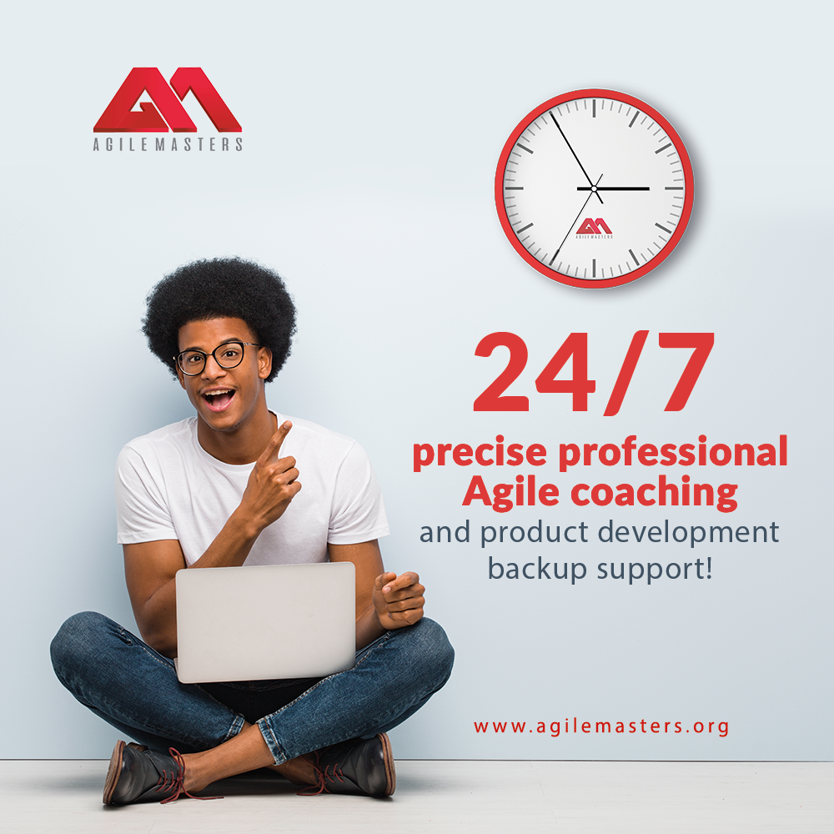
BENEFITS TO the country?
# Economic Development
1. Enhanced Workforce Skills: Agile training boosts workforce efficiency, increasing productivity and economic growth.
2. Increased Employability: Agile certification make graduates more attractive to employers, reducing unemployment and strengthening the economy.
3. Attracting Foreign Investment: A skilled workforce attracts foreign investors, boosting the economy and creating jobs.
# Industry Growth
1. IT Sector Boost: Agile practices enhance project completion speed and efficiency, strengthening the Country’s IT sector.
2. Startup Ecosystem: Agile methodologies foster innovation and flexibility, driving the growth of startups and small businesses.
3. Improved Business Practices: Agile adoption improves project management and operations, leading to better business outcomes and growth.
# Social Impact
1. Empowerment of Youth: Agile skills and certs. empower students to pursue meaningful careers, enhancing societal well-being and reducing poverty.
2. Community Development: Employment and business growth improve living standards and social development in communities.
3. Increased Global Competitiveness: An Agile-trained workforce enhances the country’ global edge.
# Educational Advancements
1. Modernized Curriculum: Integrating Agile training keeps university programs more relevant and aligned with global industry standards.
2. Faculty Development: Agile-trained educators introduce new teaching methods, improving education quality.
3. Research & Innovation: Agile fosters continuous improvement and innovation in academic research, advancing various fields.
# Government and Policy
1. Policy Alignment: Government policies supporting Agile training aligns educational and economic strategies for national development.
2. Public Sector Efficiency: Applying Agile in government projects improves public services and resource management.
3. National Development Goals: Agile training supports industrialization, innovation, human capital development, and aligns with national strategic aims.
Agile training in the Country’ universities offers broad benefits toward driving economic growth, industry advancement, educational advances, social progress, and effective governance.
13
Notes:
Note: Insert your picture by clicking on the Picture Place Holder Icon, then send it back!

Slide 11
AGILE MASTERS
1. WORKSHOPS AND SEMINARS:
- Agile Masters conducts strategic public and private sector sensitization the on best practices for embracing ongoing Agile transformation.
- Invite industry experts to share insights.
2. SCHOLARSHIP PROGRAMS:
- Besides its established scholarship initiative for University students & workforce…
- A.M. Offers support to facilitate prospects in securing extra scholarships down to 0% co-pay.
3. COLLABORATION WITH UNIVERSITIES:
- Partner with the university to include Agile methods in their IT/Engr. and Business courses.
- Provide guest lectures and practical sessions as part of the university curriculum.
4. CERTIFICATION PROGRAMS:
- Partner with educational bodies to integrate Agile certification into the school’ curriculum.
5. MENTORSHIP PROGRAM:
- Avail its community of Agile Experts to offer students 24/7 live Agile coaching support.
- Host Instructor-led live Q&A Sessions to address students’ applicable challenges.
6. INTERNSHIP OPPORTUNITIES:
- Network remote internships for students seeking broader careers in Agile Practices.
- Expand the existing internship program to overtime accommodate more students.
How Else Does
7. REAL-WORLD PROJECTS:
- Involve trained professionals in real-world Agile projects to gain practical experience.
- Collaborate with students/startups/companies
to provide project-based learning opportunities.
8. ONLINE RESOURCES & LEARNING PLATFORMS:
- Constantly equip the portal/student’ dashboard with updated resources on Agile practices.
9. COMPETITIONS:
- Organize competitions on diverse Agile challenges to practically engage and equip professionals.
- Offer prizes, scholarships, and internship opportunities for winners.
10. AGILE STUDENT CLUBS:
- Support the formation of Agile Student Clubs and societies within universities.
- Provide resources & guidance for club activities.
11. NETWORKING EVENTS:
- Organize events where students get to interact with Agile professionals and showcase skills.
12. RESEARCH AND DEVELOPMENT:
- Encourage/Support/Publish research & findings on Agile methodologies within the universities.
13. COMMUNITY BUILDING:
- Create online forums/ meetups/ groups for professionals to discuss and share Agile knowledge.
Offer Supports?
By implementing these initiatives, AGILE Masters significantly contributes to the Global Agile Transformation Drive through the Education Sector.
9

Slide 12
Introduction to Agile –
Scrum Fundamental Certified
A Compulsory-for-all TRAINING PROGRAM
This is a 3hours Instructor-led Live-Class
tailored to help everyone get the basic understanding and key concepts of the Agile framework with how it enhances the delivery of successful projects,
plus specifically what to expect from the main course.
Achievements | Continuous Learning
In attending the live classes, complete the self-study materials, and professional exams, Participants get to achieve the proposed certifications with a total 2.5CEU as they thereafter explore the 24/7 interactive Agile Experts Community for live coaching and support for practically addressing of daily challenges, increase productivity, and boosting of workplace confidence.
This include access to internships & Job Securities.
PROGRAM PLAN
Phase I
Phase II
Phase III
Phase IV
The Agile Sensitization Webinar:
Pilot Program – Fridays 2-3pm WAT
This is a 60mins Agile Expose’ where prospective participants get better clarity or information on the
Agile Training & Certification Program
With potentials of their prospectively enrolled course.
Taking advantage of this pre-event to understand who/ What/ When/ Where/ Why/ How/ How much is truly required to getting Agile Savvy & Certified.
The Major Courses
Scrum Master | Leading SAFe Certified | etc.
This is a 4-day training that empowers experts to create a conducive project environment, facilitate Scrum practices, remove team’ impediments, build business agility & enhance productivity with diverse engagements. This training aligns any organization/ teams around clear objectives and improves value with flow of work from strategy to delivery.
16

Slide 13
JOIN us
In this Agile Transformation Drive…
As We Get Every Students & Corporate Workforce
AGILE SAVVY & Certified!
+1 [332] 249-7355 | +234 [916] 326-8690 agilemasters.org@gmail.com | www.agilemasters.org
Level 85 – One World Trade Center, New York – NY 10007
WWW.AGILEMASTERS.ORG
Notes:
Note: Insert your picture by clicking on the Picture Place Holder Icon, then send it back!

